Slide 1
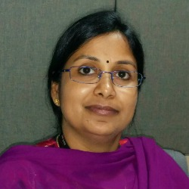
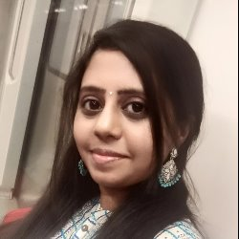
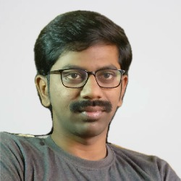
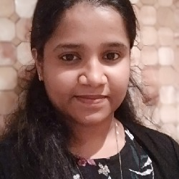
Dinesh Lakshmipathy
Salesforce & B2B Wireless - Assisted Channel
Proposed Org Chart -- 2
66
VZ
India
FTE
30
On Premise
Vendor
19
SOW
ODC
Vendor
9
ADM
Sweta Ramprakash
Sr Mgr
Salesforce Vzw, Vz1, Salesforce COE, WFM, RPA, TCMS and EzTracker, FiveStar, CERS, TM, BASE, VzBCC
Tarkeshwari Maudgil
Sr Mgr
Salesforce Vzconnect, Salesforce Partner Channel, Consumer,
Salesforce Data Integration
43
22
13
19
8
16
Suja Rajendran
WFM, RPA,TCMS,EzTracker, FiveStar, PRM Web App, CERS, TM, BASE, VzBCC
23
5
0
Sai Ramachandran Vetrivhel
Salesforce Vz Connect
8
4
0
Asha James
Vzw,Vz1
Salman Mohammed
Salesforce Consumer, PRM (Salesforce Partner Channel)
6
4
6
21
17
13
SFDI
SFDI
1
0
10
Onshore Sr Mgrs : Ashish Ben, Nishant Jain, Subbareddy K, Madhuri, Poppy Javid
Onshore Sr Mgrs : Poppy Javid, Jenny Ward

Slide 2



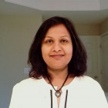
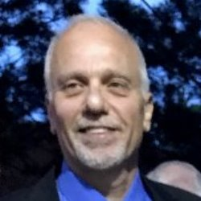
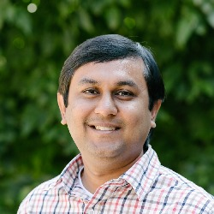
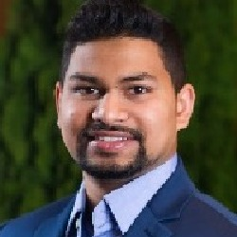

Nicole Sohoni
Salesforce & B2B Wireless - Assisted Channel
10
4
0
0
45
FTE
46
T&M
83
SOW
14
Amber
Ashish Ben
Sr Mgr
Wireless & Wireline SF B2B; B2Bgo; iQBR; Marketo (VES/VzW)
Madhuri Muluka
Sr Mgr
ezTracker; CERs; Vz2; ezQuote; Territory Manager
5
2
11
7
6
9
17
3
Jenny Ward
Sr Mgr
VzConnect
Poppy Javid
Sr Mgr
Wireless & Wireline Data Integrations; Partner Channel; BASE; SMBC; BCC.
4
0
41
41
7
11
5
2
Erik Augustine Krevh
VzC Business System Administration
Nishant Jain
Sr Mgr
WFM Modernization, RPA, TCMS, VAMS
5
2
0
0
2
6
1
0
Vasanth Parvatagiri
VzC Development
Subbareddy Kalakota
Sr Mgr
WFM BAU, BIS Reporting
1
3
0
0
5
9
8
0

Slide 3
Nicole Sohoni
Salesforce & B2B Wireless - Assisted Channel
10
4
0
0
Ashish Ben
Sr Mgr
Wireless & Wireline SF B2B; B2Bgo; iQBR; Marketo (VES/VzW)
Madhuri Muluka
Sr Mgr
ezTracker; CERs; Vz2; ezQuote; Territory Manager
5
2
11
7
6
9
17
3
Jenny Ward
Sr Mgr
VzConnect
Poppy Javid
Sr Mgr
Wireless & Wireline Data Integrations; Partner Channel; BASE; SMBC; BCC.
4
0
41
41
7
11
5
2
Erik Augustine Krevh
VzC Business System Administration
5
2
0
0
Vasanth Parvatagiri
VzC Development
1
3
0
0

